Slide 1
HF Operation
John K4VMG

Slide 2
Quick Survey
How many Extras, Generals and Technicians?
How many people in here operate HF a lot
How many people occasionally operated HF?
How many have never or rarely operated HF

Slide 3
HF Frequencies
160 Meters ... 1.8 to 2.0 MHz
80 Meters ... 3.5 to 4.0 MHz
60 Meters ... 5332 to 5405 kHz (5 2.8 kHz Channels) 40 Meters ... 7.0 to 7.3 MHz
30 Meters ... 10.1 to 10.150 MHz
20 Meters ... 14.0 to 14.350 MHz
17 Meters ... 18.068 to 18.168 MHz
15 Meters ... 21.0 to 21.450 MHz
12 Meters ... 24.890 to 24.900 MHz
10 Meters ... 28.0 to 29.7 MHz

Slide 4
Why so many bands?
Each band is different
Long Range vs Short range
Noise levels
Day vs Night
Summer vs Winter

Slide 5
Which band to use?
Lower bands (160m-40m)
  Better in winter
  Better at low sunspot activity
  Local in day, DX at night
Higher Bands
  Better in Summer
  Better during high sunspot activity
  DX in daytime closed at night

Slide 6
Types of transmission
CW or morse code
AM
FM (10m and above)
SSB (Lower and Upper)
Digital (FT8,FT4,RTTY, PSK & Packet)

Slide 7
Who goes where? (Generally)
Each country has band specific allocations
In USA
  CW Permitted on any frequency
  CW generally found at lower end of band
  Digital just above CW
  Phone normally upper ½ to ¾ of band
    USB 40m and above
    LSB 30m and below

Slide 8
Equipment required for HF
HF Transceiver usually 100w with power supply
  Could be new generally $800 and up
  Secondhand $300 and up
  Homebrew $200 and up
Antenna
  Vertical, dipole, end fed or beam
Antenna Tuner (maybe)
Go QRP/Portable for one third of the cost

Slide 9
What happens on HF
Ragchew
Nets (on virtually all aspects of Ham Radio)
Contesting
Award Chasing
Emergency work

Slide 10
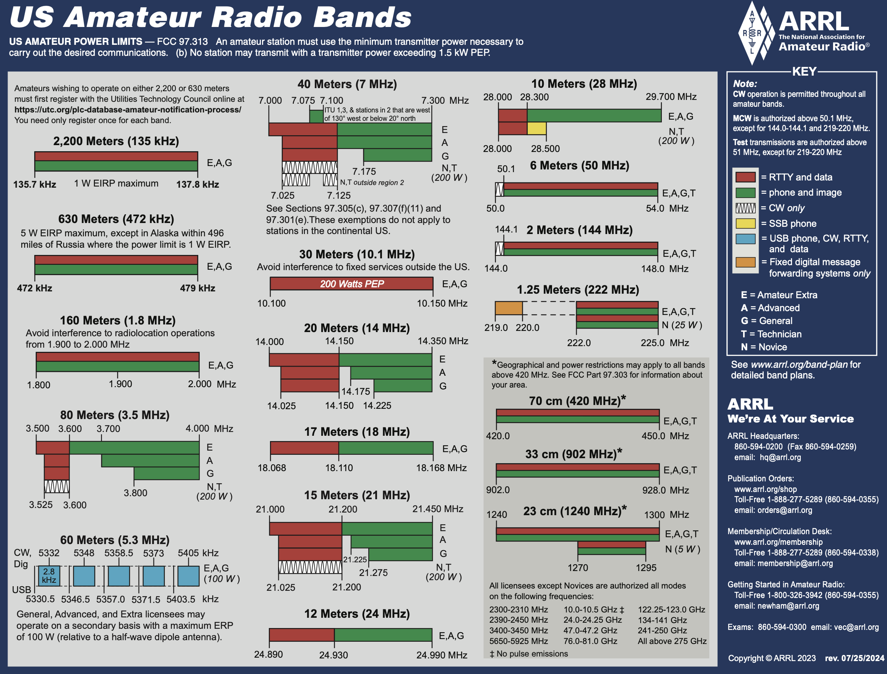
One pager

Slide 11
Avoid going out of band
On SSB the bandwidth is generally 3khz
Stay AT LEAST 3hz away from the edge of band
  On LSB 3khz ABOVE the bottom edge
  On USB 3kx BELOW the top edge

Slide 12
Making contacts?
First of all find a clear frequency
Listen and listen again
Ask “is this frequency in use? Or send QRL in cw
Typical call phone
  CQ CQ CQ this is K4VMG, then phonetically, K4VMG standing by for any calls
Typical call cw
CQ CQ DE K4VMG K4VMG CQ DE K4VMG K

Slide 13
Logging and QSL’s
There is no legal requirements to either log or send QSL’s however
  The majority of stations use a logbook (paper or PC)
  The majority of stations send QSL’s
    Cards via the bureau, direct or via managers
    Electronic QSL via LoTW, QRZ, ccLog or many others
If you want awards then you need to log and QSL
Info required Date and time (UTC), Frequency, their callsign, their report (RST)

Slide 14
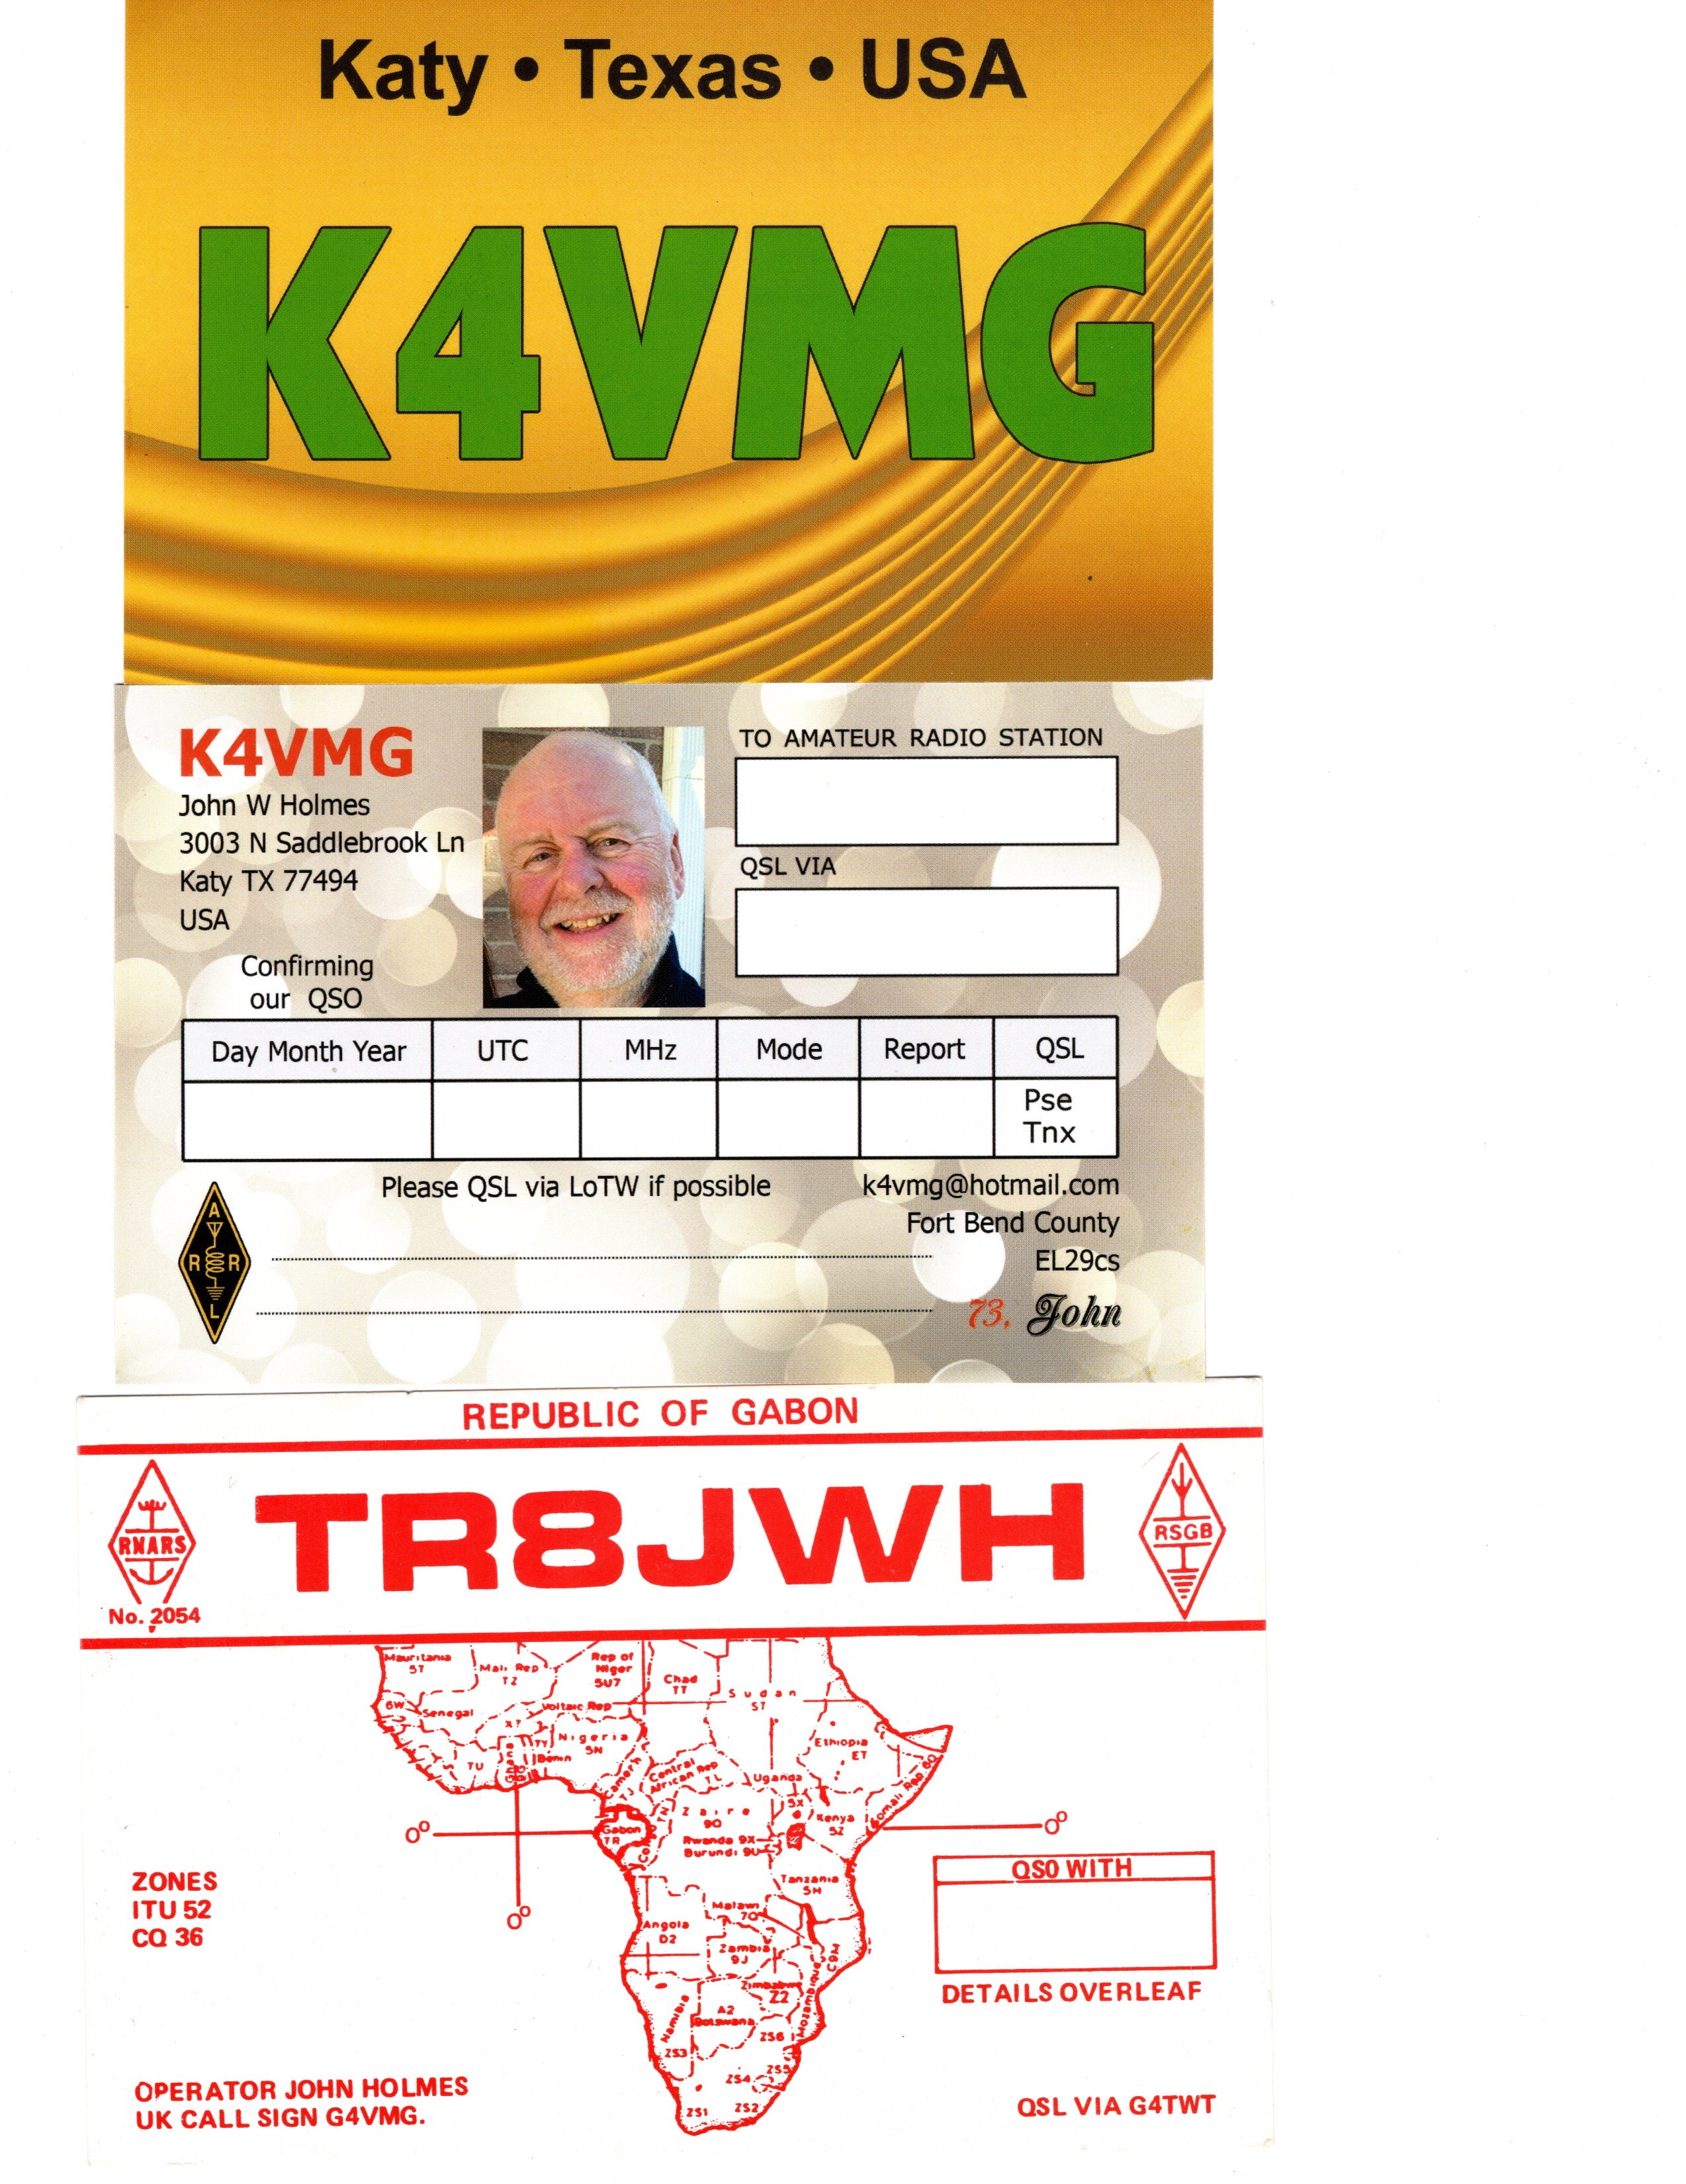
QSL CARDS

Slide 15
Awards
There are awards for virtually everything
Most common ones are
  DXCC -100 DX entities (Countries 195, DXCC 340)
  WAS Worked all States
  WAC Worked all Continents
  VUCC VHF/UHF 100 Maidenhead Squares (750USA)
Endorsements for band and mode and power

Slide 16
HF Opportunities
Elmers and Mentors
Field Days (2025 is Jan 25th /26th)
Club Events
Fellow Hams

