Slide 1
HF Antennas
The Basics Part 1 The dipole

Slide 2
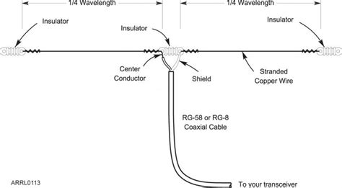
The Simple Dipole

Slide 3
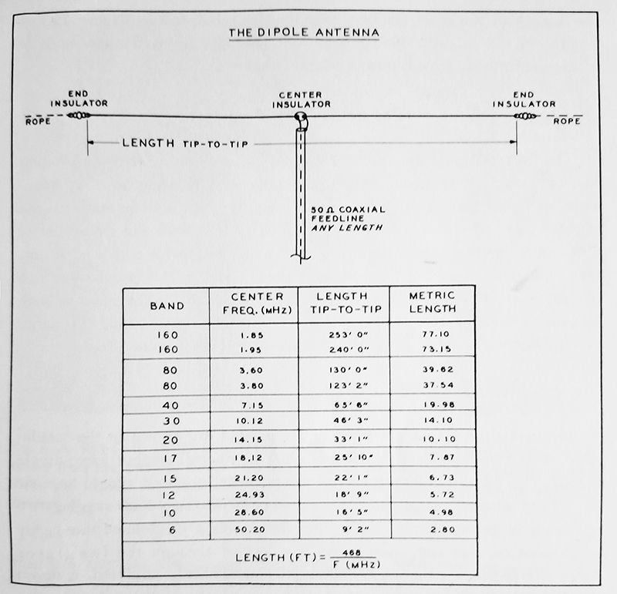
Dipole leg lengths (468)

Slide 4
Dipole types
Inverted V
Half wave Sloper
Offcenter Fed
Loop Dipole
Trap Dipole

Slide 5
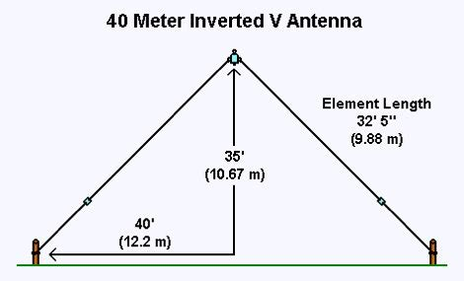
Inverted V
Centre Fed
Feed point higher than ends
Equal lengths either side of feed
Used when space is limited

Slide 6
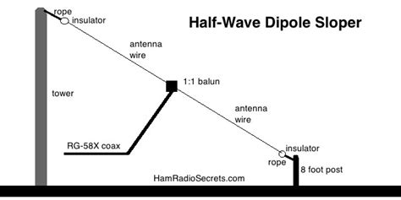
Half Wave Sloper
Used to get some directional qualities
Useful when you have just one high point

Slide 7
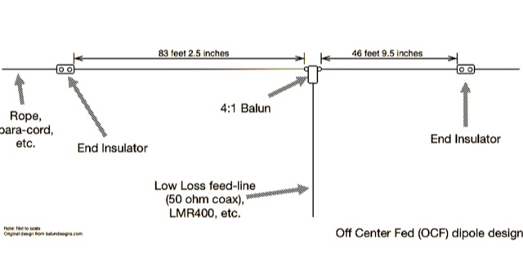
Off-centre Fed
Space limitations may enforce this design
Impedance changes as you move away from the centre feed point
Can be used for multiband when designed for 80m (harmonics)
Will serve for 80/40/20 and 10m

Slide 8
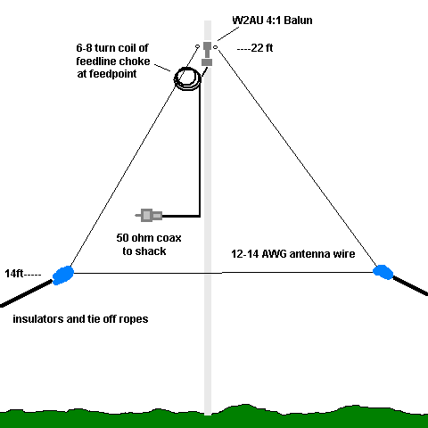
Delta Loop Dipole
Space saving but can require a lot of wire
10 meters: 34.84 feet
12 meters: 40.29 feet
15 meters: 47.35 feet
17 meters: 55.47 feet
20 meters: 70.55 feet
30 meters: 97.19 feet
40 meters: 140.56 feet
75/80 meters: 269.80 feet
160 meters: 528.9 feet

Slide 9
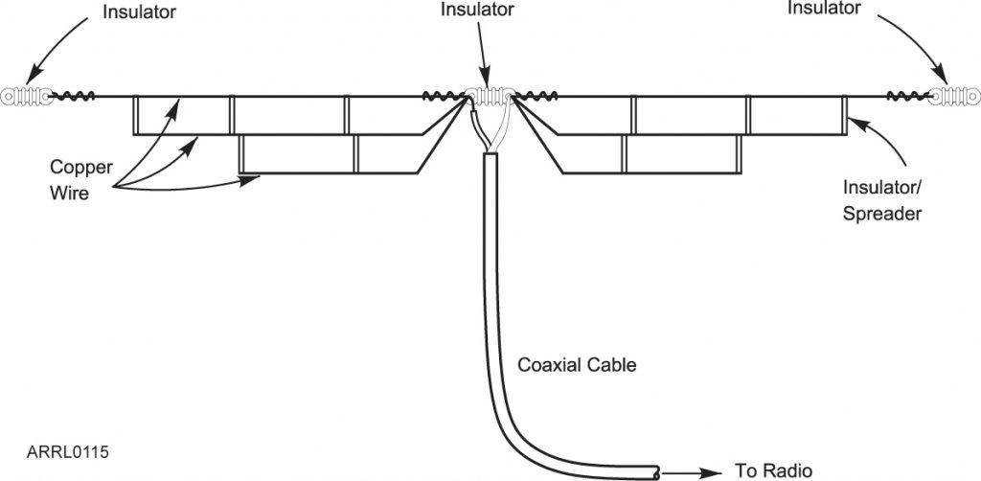
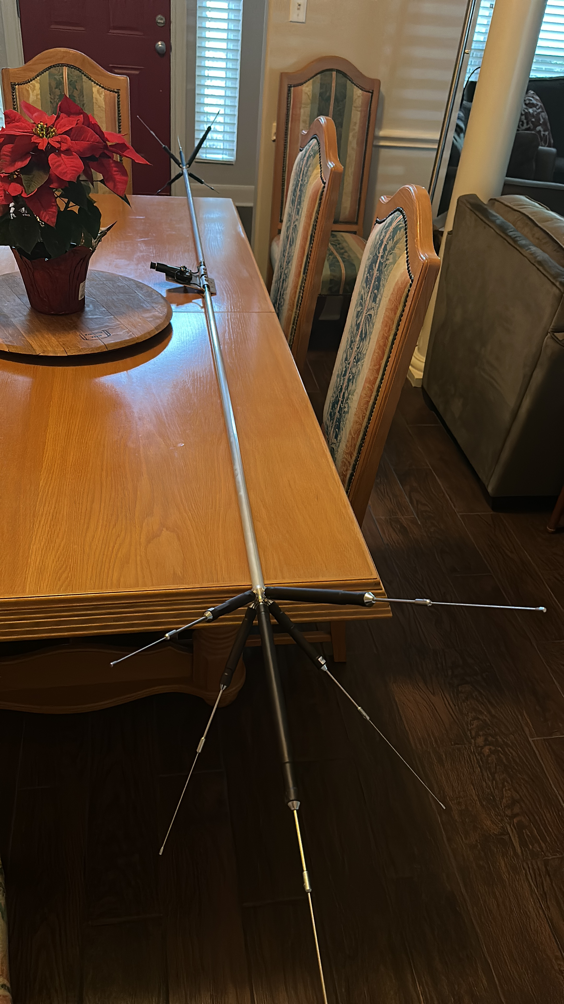
Trap Dipole (or fan dipole)

Slide 10
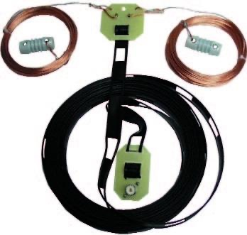
G5RV
Invented in 1946 by Louis Varney
Is only 102ft across or 51ft for the G5RV Jr
Will match on all bands 80m-10m (40-10 Jr)with simple tuner
Uses 31ft ladder line as feed
Simple to home brew
Works with any configuration

Slide 11
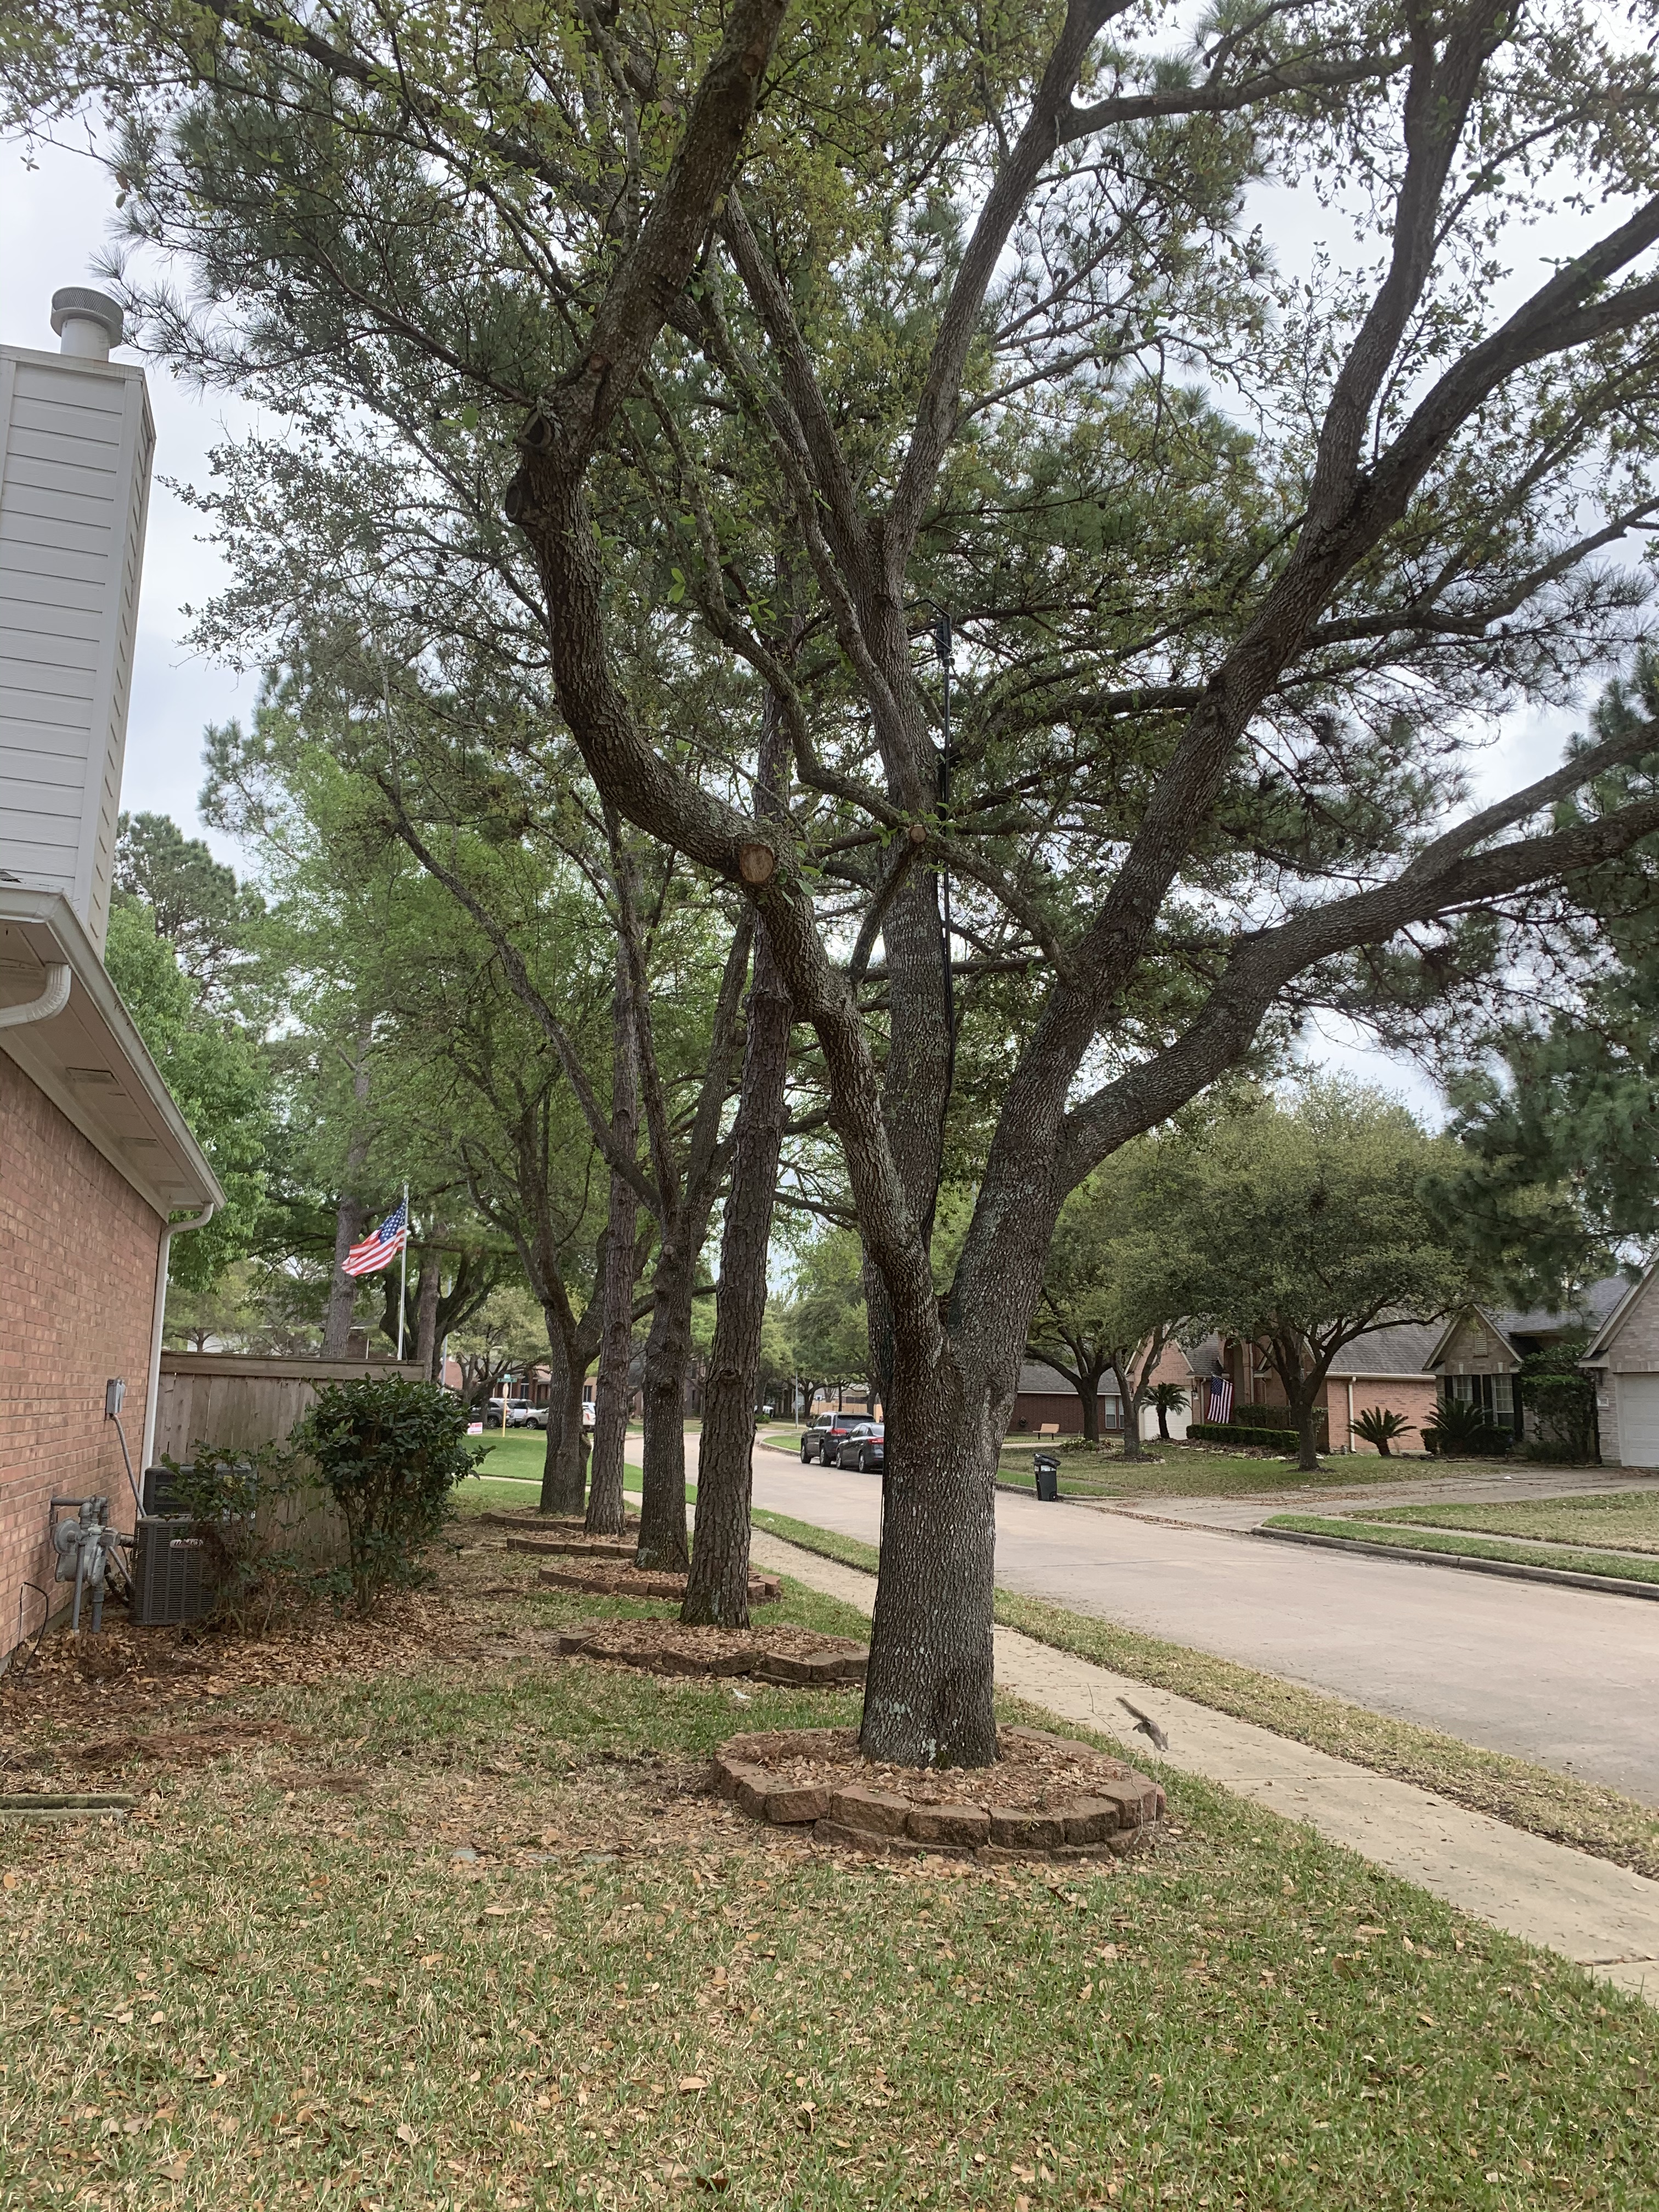
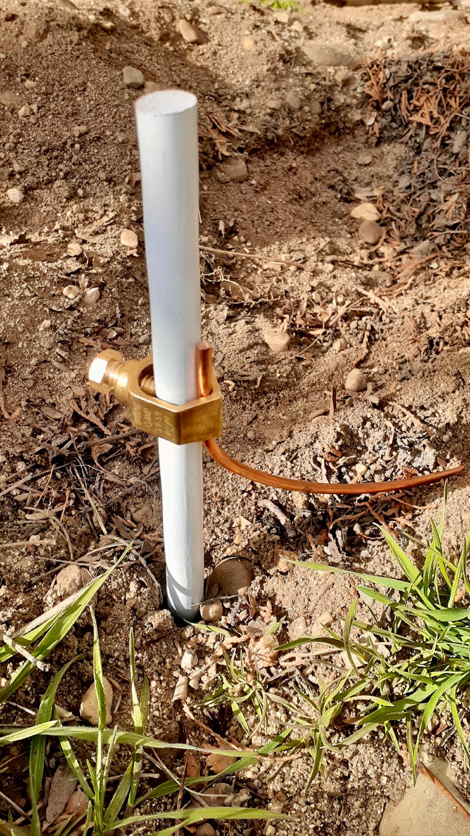
Questions

